Slide 1
Semi-join Investigation

Slide 2
Outline
Generalized Semi-join Reduction
Eager and Lazy Aggregation
Results

Slide 3
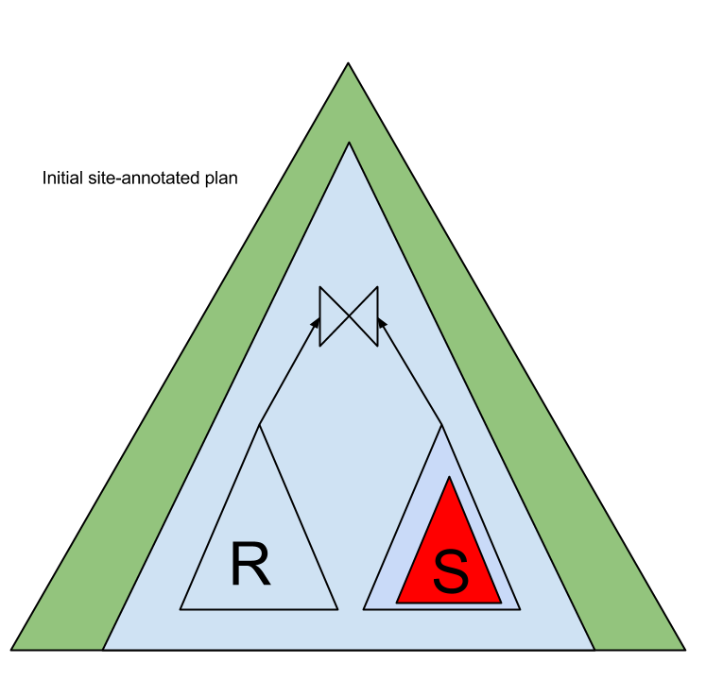
Generalized Semi-join Reduction
We have two relations R and S on sites s1 and s2 respectively.
Distributed input plan with the proper site annotation.
Assume equal query capabilities across data sources.
Colors indicates the sites at which plans are executed.

Slide 4
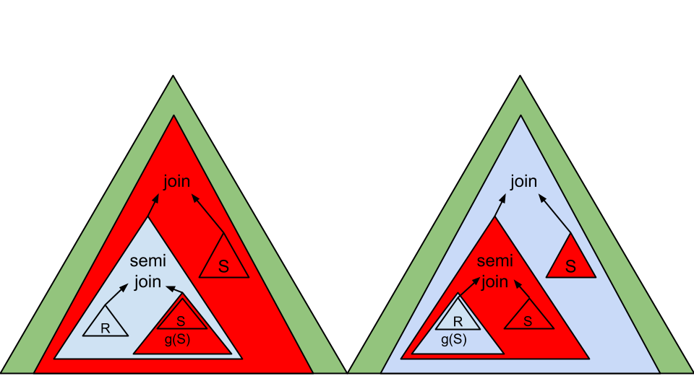
Rewritten query plans
Notes:
Figure out the order of rewritings
Greedy optimizer

Slide 5
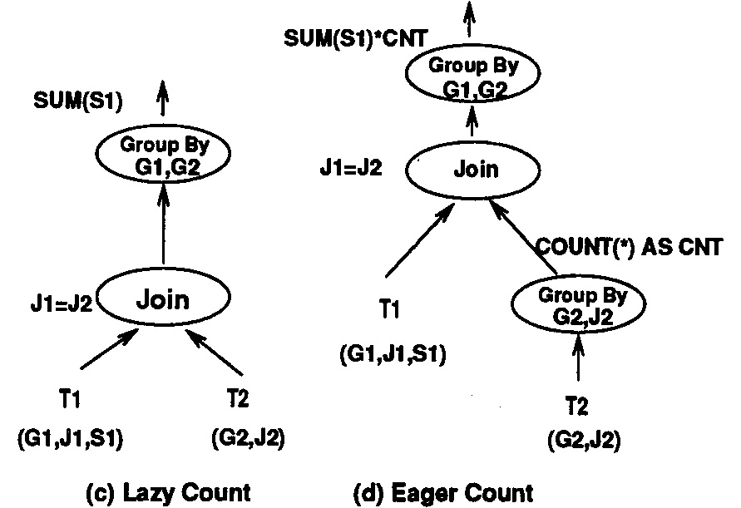
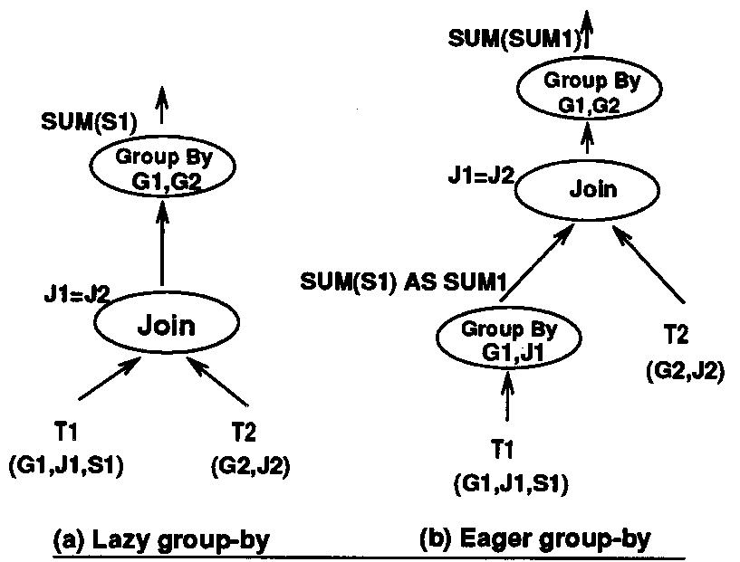
Weipeng P. Yan, Per-Ake Larson [U. of Waterloo]. Eager Aggregation and Lazy Aggregation. PVLDB 95
Join and Aggregation rewriting rules are all described in this paper. Any of my findings on the subject is a variant from these rules.

Slide 6
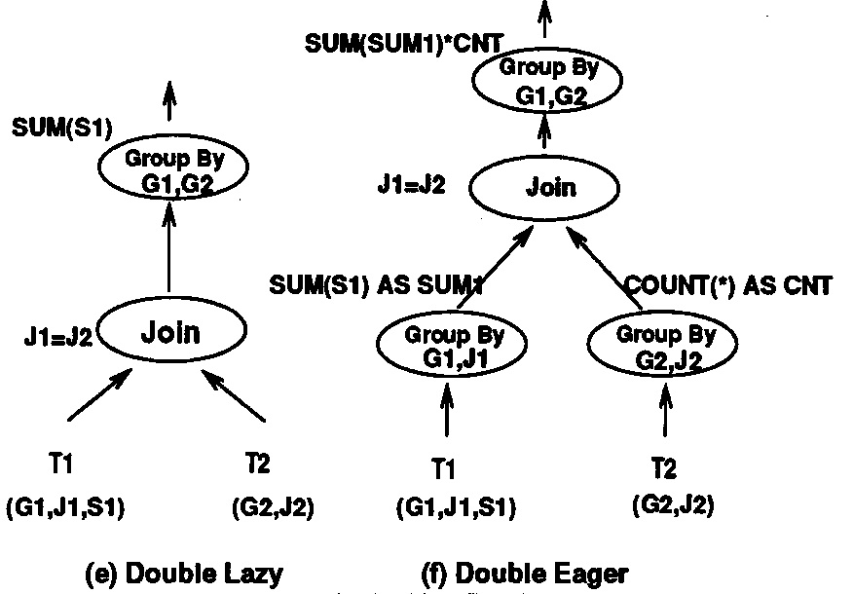
Weipeng P. Yan, Per-Ake Larson [U. of Waterloo]. Eager Aggregation and Lazy Aggregation. PVLDB 95

Slide 7
Weipeng P. Yan, Per-Ake Larson [U. of Waterloo]. Eager Aggregation and Lazy Aggregation. PVLDB 95
Both eager and lazy aggregation should be considered (examples in the paper prove it).
Decomposable functions
Class C functions
Class D functions

Slide 8
Eager and Lazy Aggregation Optimization in a MiddleWare setting
The following papers all quote the lazy aggregation articles and are concerned with middleware:
Exploiting early sorting and early partitioning for decision support query processing. J. Claussen∗, A. Kemper, D. Kossmann∗∗, C. Wiesner [VLDB2000]
Optimal Aggregation Algorithms for Middleware. R. Fagin, A. Lotem, M. Naor [JCSS2002]
Optimizing Queries With Aggregate Views. S. Chaudhuri, K. Shim
Query Evaluation Techniques for Data Integration Systems. Christian Wiesner, [Doctoral Thesis, U. of Passau 2004]

Slide 9
Results
Bad News : every possible logical rewriting can be derived by existing rewriting rules.
There are no logical rewritings a state of the art query processor would not evaluate.
Bigger picture : despite being able to consider all logical rewritings, will an existing query processor miss physical opportunities in a middleware setting?
How would we implement a semi-join reduction rewriter coupled with a eager/lazy aggregation rewriter such that all possible physical plans involving these two rewriters are evaluated?

Slide 10
Implementation
We have made the point that a query processor that implements rewriters for both semi join reduction and eager/lazy aggregation should evaluate all possible distributed physical plans involving joins and aggregations.
The architecture of such a query processor has, however, not been described. We have to answer the following questions :
What is the assumed underlying architecture of the distributed query processor.
How are the two rewriters implemented within the query processor.

Slide 11
Assumed Architecture for distributed query processor
Assume State-of-the-art, “Starburst”-like architecture

Slide 12
Required meta-information for rewriters
Eager/lazy aggregation rewriter :
selectivity of a join operation
selectivity of an aggregation operation
no information about distribution of data (this rewriter is unaware of distribution)
cost of an aggregation and join operations.
requires number of tuples for each relation.
number of distinct values per join / aggregation attributes for each relation.
Semi-Join Reduction rewriter :
selectivity of join operation.
cost of join/semijoin operation.
requires number of tuples for each relation.
number of distinct values per join / aggregation attributes for each relation.
location of joined tables.
Communication cost per byte between sources
cost of a projection
Notes:
This cost can be define as the I/O cost (number of block accesses) performed by the query processor for the aggregation operation.

Slide 13
Catalog
We assume a catalog is present with meta-information expected from a state of the art query processor.
Schema of each relation
Partitioning Schema
Physical Information
Per byte / location specific communication costs
Location of each table
Permissions/capabilities of each source
Catalog is assumed to be stored on the middleware.
Notes:
Catalog

Slide 14
Query Optimization
Assume classic dynamic programming approach to plan enumeration
Assume iterator model and pipelining.
Assume garlic cost-based optimizer
Assume equal source capabilities

Slide 15
STARs for rewriters
Semi join Reduction

Slide 16
STARs for rewriters
Eager/Lazy Aggregation

Slide 17
STARs for rewriters
Extra rewriters for eager/lazy aggregation could be added :
Eager count
Lazy count
Double Eager/Lazy Count/Groupby
Could use recursion in STARs to push aggregations down a join tree

Slide 18
Example Architecture
Eager/Lazy Aggregation added in phase 1 of Garlic’s dynamic programming algorithm.
SemiJoin Reduction added in phase 2 of garlic’s dynamic programming algorithm as an additional garlic join method.

Slide 19
Example Query
Example : Assume that we have the two tables :
Employee(EmpID, LastName, FirstName, DeptID)
EmpID is the primary key in the Employee table.
Employee is on source S1.
Department(DeptID,Name, Logo)
DeptID is the primary key of Department
Each Employee row references the department (Dep￼￼tID) to which the employee belongs.
Department is on source s2.
Logo information is a big PNG image.
Consider the following query :
SELECT D.DeptID, D.Name, D.Logo, COUNT(E.EmpID)
FROM Employee E, Department D
WHERE E.DeptID = D.DeptID
GROUP BY D.DeptID, D.Name, D.Logo

Slide 20
Statistics Available
Employee :
#tuples : 10,000,000
#foreign keys : 100,000
#size of a tuple : ~100bytes
Department :
#tuples : 100,000
#size tuple with logo: ~100kB
#size tuple without logo: ~50bytes
Transfer speed (over WAN): 10 MB/sec

Slide 21
Input Plan

Slide 22
Plans after phase 1 of Garlic’s query optimizer

Slide 23
Plans after phase 2 of Garlic’s optimizer (distributed)
Notes:
1) Connection of the new STARS with the required normal forms for finish rules to work.
2) Extend the garlic architecture to include NoSQL sources and see if the STARS break at one point.

Slide 24
More Examples
In this simple example, the suggested architecture gives the optimal distributed plan. What about more complex cases?

